Slide 1
Microsoft Online Office 365 Administration with PowerShell

Slide 2
In this Video, we are going to take a look at…
The ability to connect to online Microsoft services within the console
Get information regarding Microsoft Office 365 subscription accounts

Slide 3
Prerequisites
Microsoft Online Services Sign-in Assistant
Microsoft Azure Active Directory Module for Windows PowerShell
PowerShellNewbie.com/Resources

Slide 4


Slide 5
Remember! You Are Connecting to a Service
Notes:
Something that needs to grab the viewers attention!!

Slide 6
Your Account
Notes:
Something that needs to grab the viewers attention!!

Slide 7
Your Permissions
Notes:
Something that needs to grab the viewers attention!!

Slide 8
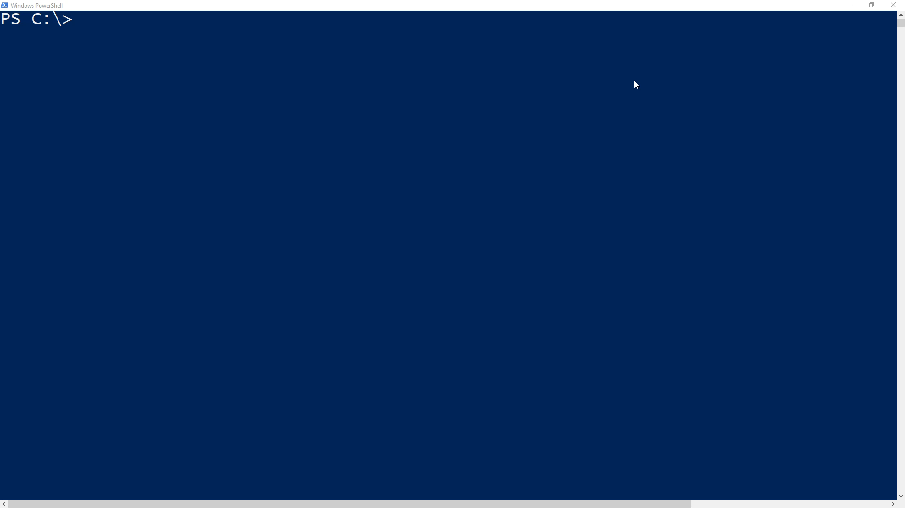

Slide 9
Dynamic
Notes:
Something that needs to grab the viewers attention!!

Slide 10
IIS Web Server Administration with PowerShell
Next Video

